Slide 1
Image Processing
Camshift
James Connan

Slide 2
Camshift
Camshift is based on Mean-shift
  Procedure for detecting the maxima of a density function
Effective colour based tracking system
Climbs density grades to find the peak of probability distributions
Uses search window
Iteratively calculates the maximum distribution and moves the window

Slide 3
Mean-shift
Mean-shift algorithm
  Choose a search window size
  Choose an initial position for the search window
  Compute the mean location in the search window
  Centre the search window at the mean location
  Repeat step 3 and 4 until it converges

Slide 4




Mean-shift
Mean location
  Statistical moment
    of order p and q
  Zero-order moment
  First order moments
  Position of target object
    Centroid

Slide 5
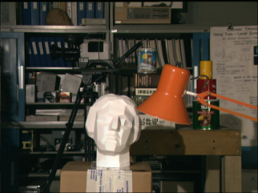
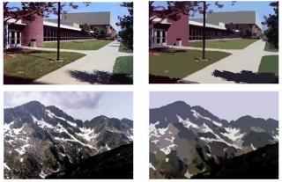
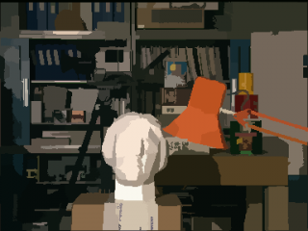
Applications

Slide 6
Mean-Shift
Mean-Shift is based on static distributions
Not well suited to video
Continuously Adaptive Mean Shift Algorithm
  CAMSHIFT

Slide 7
Camshift
Camshift Algorithm
  Choose initial location of the search window
  Mean Shift as above (one or many iterations); store the zero order moment.
  Set the search window size equal to a function of the zero order moment found in Step 2.
  Repeat Steps 2 and 3 until convergence (mean location moves less than a pre-set threshold)

Slide 8
Camshift
Operates on a colour probability distribution
Colour probability distribution derived from colour histograms
Colour probability distribution only calculated for region surrounding the current CAMSHIFT window
Coupled CAMSHIFT algorithm

Slide 9
Camshift
Coupled CAMSHIFT Algorithm
  Set the calculation region of the probability distribution to the whole image.
  Choose the initial location of the 2D mean shift search window.
  Calculate the colour probability distribution in the 2D region centred at the search window location in an area slightly larger than the mean shift window size.
  Mean shift to convergence or for a set number of iterations. Store the zero order moment (area or size) and mean location.
  For the next video frame, centre the search window at the mean location stored in Step 4 and set the window size to a function of the zero order moment found there. Go to Step 3.

